Slide 1
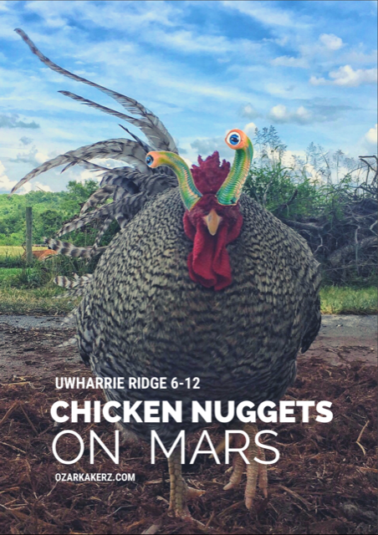
MARS
<Name>
<Date>

Slide 2
Agenda
Introduction
Heritage breeds
Sustainable and regenerative farming practices
Coop Design

Slide 3
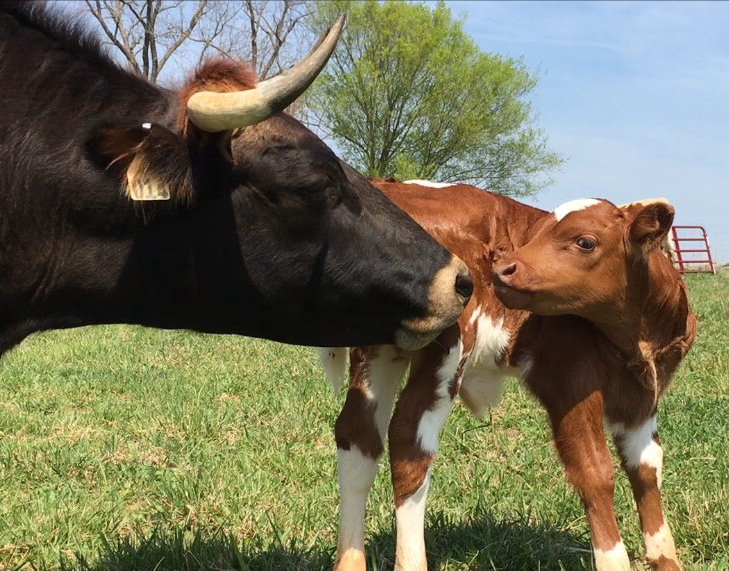
Heritage Cattle - Pineywoods

Slide 4
Heritage Turkeys – Blue Slate

Slide 5
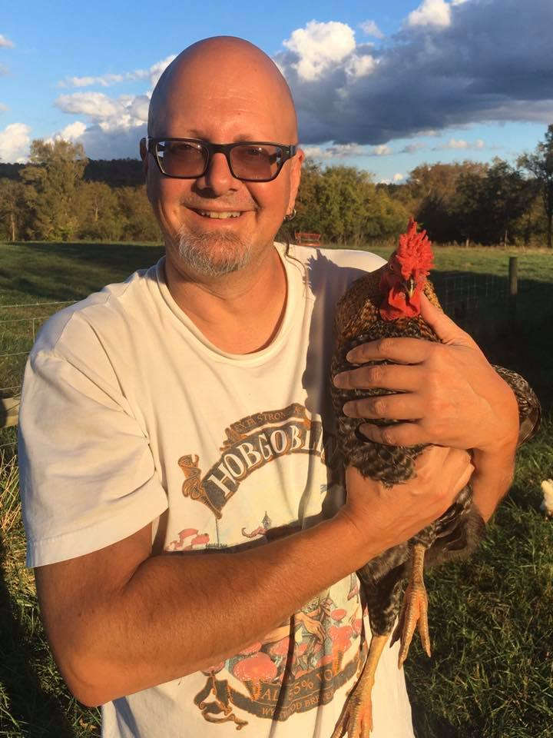
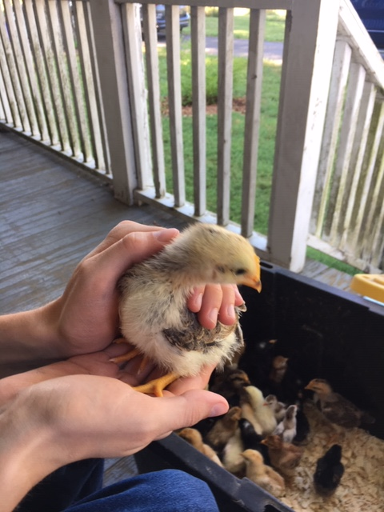
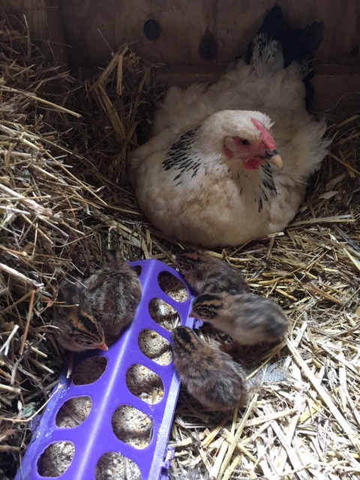
Heritage Chickens

Slide 6
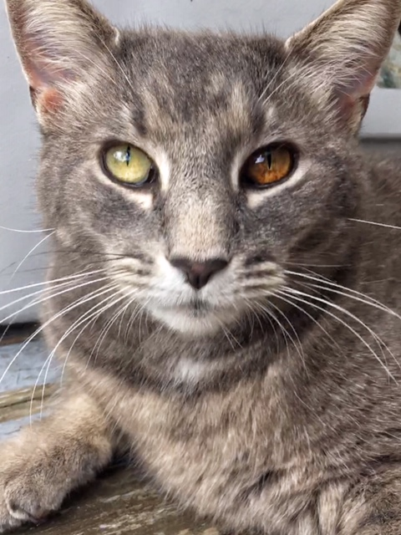
Farm Cats – Lemmy and Bones

Slide 7
Heritage Breed Chickens
Heritage breeds are endangered farm animals
Quad Breed
Eggs
Traits
Meat
Insect control
Long, productive outdoor lifespan
Fertilizer
Thrive on pasture
Hens lay eggs from 5-7 years
Hardy birds – e.g. cold temperatures

Slide 8
Heritage Breeds – Find the best breed
Form Groups and choose 3 breeds you think will do well on mars
Resources:
The Livestock Conservancy - Breed Comparison Chart
https://livestockconservancy.org/images/uploads/docs/pickachicken.pdf
Look for
Cold hardy breeds
Breeds that are good foragers
That are good for eggs and meat
Broody – they sit on eggs to hatch them
Good mothers – some don’t protect their chicks so well
Breeds that don’t take much experience by humans to raise

Slide 9
What do chickens eat?
Lots of things! More on our YouTube channel
https://youtu.be/eaOdL-VwZ-Y
Subscribe to our Graze Against The Machine channel to view more videos as they
are uploaded

Slide 10
Sustainable and Regenerative Farm practices
https://study.com/academy/lesson/what-is-sustainable-agriculture-definition-benefits-and-issues.html
Sustainable:
Like your great-great-grandparents farmed
Natural practices
Grow and use as much as you have
Select the right breed of poultry or livestock for your environment
Recycle and repurpose
Regenerative: E.g. making the soil healthier, increasing worms and microbes. Healthy soil = healthy plants

Slide 11
Feed Kitchen scraps to chickens
Eggs feed us and our community
Shells (calcium) are used on garden and fed to chickens
Roast or fried Chicken
Bones, heads and feet for broth
Bury bones in garden as slow release fertilizer
Poop and organic straw from coop is fertilizer for the garden
Grow healthy veg
How does Ozark Akerz use chickens in our sustainable and regenerative model?

Slide 12
Chicken Coop Design
What we’ve learned
Design principles:
Predator proof
Ventilation
Store litter (straw, pine shavings etc) nearby – note don’t use cedar shavings!
Windows/shutters and doors to allow sunlight in
Roosts for sleeping
Nesting areas to lay eggs (optional if birds are free-range)
Separate area for mammas and baby chicks, injured chickens, new chickens
Make the coop bigger than you think you’ll need so you can add more chickens
You can read a lot on the internet about the amount of space you need per chicken, but most are too little. Think about yourself, how much space do you need to live, play, eat etc to feel comfortable versus the minimum space you need to survive

Slide 13
Chicken Coop Design
Learn about the dimensions, ventilation, predator protection, roosts, nursery and more we considered when building our chicken house
https://youtu.be/NtfKUZJ8DKA
Subscribe to our Graze Against The Machine channel to view more videos as they
are uploaded

Slide 14
Chicken Nuggets on Mars – Other things to think about
Genetic diversity – inbreeding can weaken the hardiness, mothering abilities, introduce disease susceptibility etc
Can you grow your own straw for the coop, is there an alternative?
Are there other places in your mars city that you can get food scraps from?
Chickens eat insects, mice, snakes, grass, grains, greens and much more, try to create an ecosystem that sustains itself
Chicken Tractor as an alternative to a stationary coop
Will the chicken ecosystem be part of the humans eco system or self contained?
Dust baths – help keep mites away
Can you use the feathers for pillows or making fishing lures for ice fishing
Will lower gravity…
Effect integrity of the egg shell?
Mean that eggs float away?
Mean that chicks will grow quicker or slower inside the shell
Mean that chickens might harm themselves by running/flying into obstacles because they are faster?

Slide 15
ozarkakerznc@gmail.com
www.ozarkakerz.com

